Slide 1

CAPSTONE PROJECT
Smart Tourism Package Recommendation and Booking Platform
CSA0905 – JAVA PROGRAMMING
PRESENTED BY:
Saran.S (192473003)
R. Kalyan Kumar Reddy(192472274)
B. Karthik Ratan(192372051)
UNDER THE SUPERVISION OF: DR.SIVASANKAR C

Slide 2


PROBLEM BACKGROUND
Current Scenario:
Travelers usually search for tourism packages across multiple websites, travel agencies, and social media platforms. This process is time-consuming, provides limited personalization, and often lacks real-time information on package availability, pricing, and travel updates.
Need for the Project:
An intelligent tourism platform is needed to recommend personalized travel packages based on user preferences, budget, interests, and travel history. The system should provide real-time package availability, simplify booking, and improve the overall travel planning experience.
Target Users:
Travelers/Tourists – Search, compare, receive personalized package recommendations, and book trips.
Travel Agencies & Tour Operators – Publish and manage travel packages, pricing, and availability.
Hotels & Transportation Providers – Update accommodation, transport services, and booking details.
Administrators – Manage users, travel packages, bookings, payments, and platform operations.

Slide 3

PROBLEM STATEMENT
Travelers struggle to find the most suitable travel packages from numerous available options.
Existing booking platforms provide limited personalized recommendations based on user preferences.
Comparing destinations, prices, accommodations, and transportation across multiple platforms is time-consuming.
Lack of real-time updates on package availability, pricing, and travel information affects planning.
A smart, centralized platform is needed to provide personalized recommendations and seamless booking services.

Slide 4
OBJECTIVE
To develop a smart platform for personalized tourism package recommendations based on user preferences.
To simplify the travel planning and booking process through a centralized system.
To provide real-time information on package availability, pricing, and travel details.
To enable secure and efficient online booking and payment services.
To improve user satisfaction by offering accurate recommendations and a seamless travel experience

Slide 5
Module 1 User & Tourism Package Management
To develop a centralized system for user registration, login, and profile management.
To manage tourism packages with complete information about destinations, pricing, duration, and activities.
To provide efficient search and filtering options based on destination, budget, duration, and package type.
To enable administrators to add, update, and manage tourism packages efficiently.
To provide users with accurate and updated tourism package information.

Slide 6
Module 2: Smart Tourism Package Recommendation
To develop a smart recommendation system based on user preferences and travel requirements.
To analyze user preferences such as budget, destination, duration, and preferred activities.
To recommend suitable tourism packages according to individual user requirements.
To rank and display tourism packages based on their relevance to user preferences.
To improve travel planning by providing personalized and accurate package recommendations.

Slide 7
Module 3: Booking, Payment & Review Management
To develop a smart platform for personalized tourism package recommendations based on user preferences.
To simplify the travel planning and booking process through a centralized system.
To provide real-time information on package availability, pricing, and travel details.
To enable secure and efficient online booking and payment services.
To improve user satisfaction by offering accurate recommendations and a seamless travel experience

Slide 8
LITERATURE SURVEY
Year
Title
Methodology
Findings
Research Gap
Machine Learning-based recommendation using user preferences and ratings
Improved recommendation accuracy and user satisfaction
Limited real-time travel data and dynamic pricing support
2021
Personalized Tourism Recommendation System
AI-Based Travel Recommendation Using User Behavior
Artificial Intelligence and collaborative filtering techniques
Generated personalized travel suggestions based on user interests
Did not integrate complete online booking functionality
2022
Smart Tourism Platform Using Big Data Analytics
Big Data analytics and cloud-based tourism services
Enhanced destination recommendations and travel planning
Lack of real-time availability and booking management
2023
Web-based centralized booking system with integrated travel services
Simplified package search and online booking process
No intelligent recommendation based on traveler preferences
2024
Online Tourism Package Booking System
Intelligent Tourism Package Recommendation and Booking Platform
AI, Machine Learning, and real-time analytics for personalized recommendations
Improved travel experience with personalized packages and seamless booking
Further enhancement needed in predictive recommendations and multilingual support
2025

Slide 9
Existing System vs Proposed System
Feature | Existing System | Proposed System | Advantage
Package Recommendation | Generic or manual recommendations | AI-based personalized recommendations based on user preferences | Accurate and personalized travel suggestions
Package Search | Users search across multiple websites | Centralized platform with smart search and filters | Saves time and simplifies travel planning
Booking Process | Separate booking for hotels, transport, and activities | Integrated booking for hotels, transport, and tour packages | Convenient and seamless booking experience
Real-Time Updates | Limited or delayed updates on availability and pricing | Live updates on package availability, prices, and travel information | Better planning and informed decisions
User Experience | Limited personalization and manual comparison | Personalized dashboard with recommendations and booking history | Improved user satisfaction and travel experience

Slide 10
REQUIREMENTS
Functional Requirements:
Register and manage user details. Search and view tourism packages.
Recommend packages based on user preferences. Book travel packages and manage booking details.
Non-Functional Requirements:
User-friendly interface. Fast and accurate package recommendations. Secure and reliable data storage. Easy to maintain and scalable.
Hardware Requirements: Processor: Intel Core i3 or above RAM: 4 GB (Minimum) Storage: 250 MB Free Space
Software Requirements:
Windows 10/11 Java (JDK 25)
IntelliJ IDEA Maven SQLite
DB Browser for SQLite

Slide 11
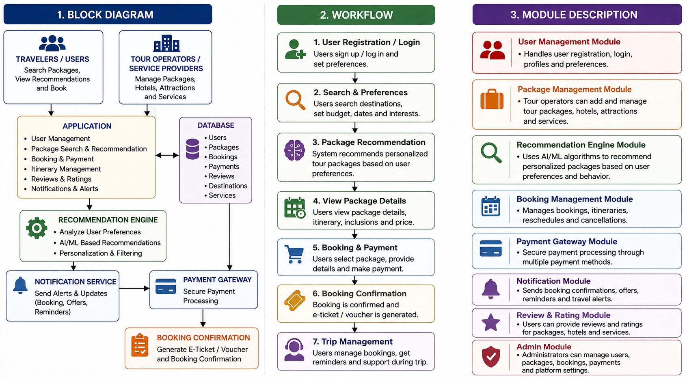
SYSTEM ARCHITECTURE

Slide 12
EXPECTED OUTPUT
Expected Output
Personalized tourism package recommendations. Secure online booking and payment.
Real-time booking confirmation and notifications. Efficient management of users and tour packages. Project Deliverables
Smart Tourism Package Recommendation and Booking application. Database for users, packages, bookings, and payments.
Source code and project documentation. Project report and PPT presentation.
Benefits
Saves time in finding suitable tour packages. Provides personalized travel recommendations. Improves user experience and tourism management. References
UN Tourism, Tourism Statistics, 2024. https://www.unwto.org
Oracle Corporation, Java SE Documentation, 2024. https://docs.oracle.com
SQLite Development Team, SQLite Documentation, 2024. https://www.sqlite.org/docs.html Oracle Corporation, JDBC API Documentation, 2024. https://docs.oracle.com/javase/tutorial/jdbc/

Slide 13


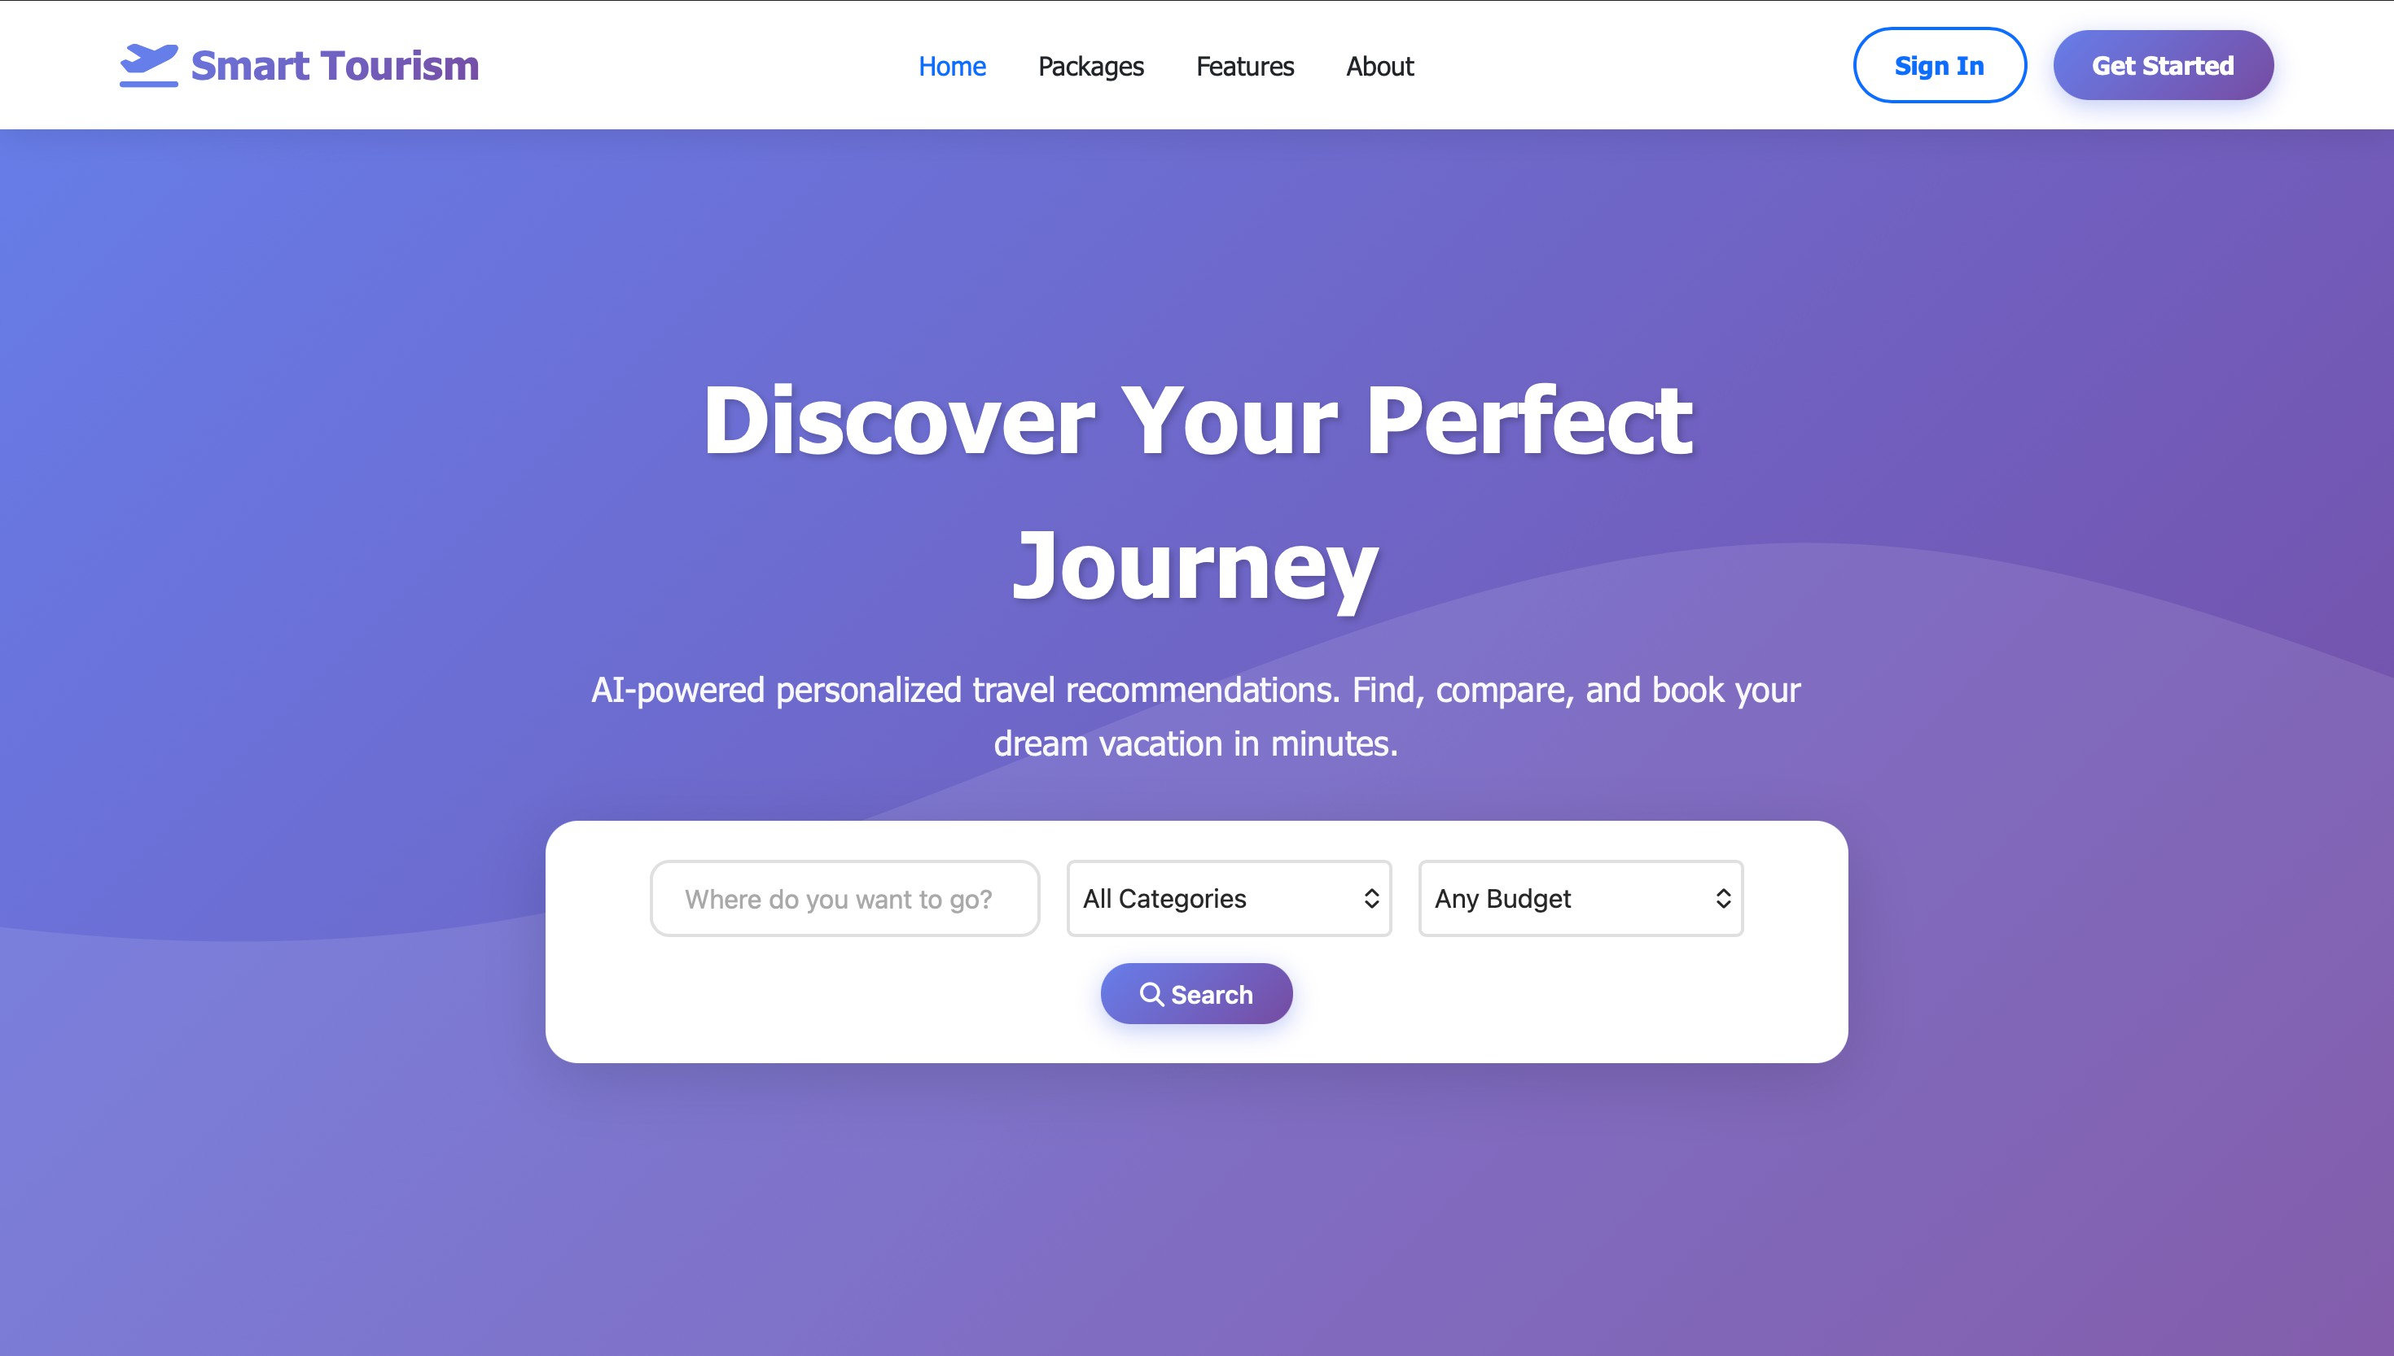
Dashboard

Slide 14
Conclusion
To develop a centralized platform for personalized tourism package recommendation and online booking.
To simplify travel planning by providing suitable packages based on user preferences and requirements.
To provide accurate information about destinations, pricing, availability, duration, and travel activities.
To enable secure online booking, payment, cancellation, and review management services.
To improve the overall travel experience through personalized recommendations and a seamless booking process.
•

Slide 15
Future Scope
To integrate advanced AI and machine learning techniques for more accurate tourism package recommendations.
To provide real-time information about flights, hotels, transportation, weather, and destination availability.
To develop a mobile application for easy access to tourism packages and booking services.
To implement an AI chatbot for instant travel assistance and personalized customer support.
To integrate interactive maps and location-based services for improved travel planning.

Slide 16
THANK YOU

